Slide 1

WEIGHING SYSTEM
(Standard Software) OPERATIONS MANUAL

Slide 2
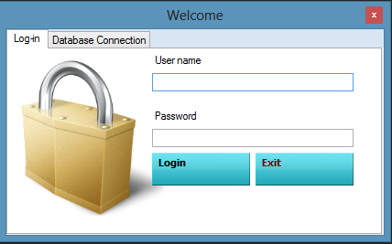
LOGIN FORM
Every user must enter the user name and password to access Weighing System. For fresh installed, user name is admin and password is 1.

Slide 3
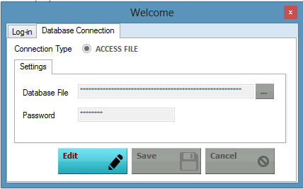
DATABASE CONNECTION TAB
In this Section, you can choose the database file (MDB file) that you want to use. Just Click
edit and click to browse to the location of the DB File, type in database password then press Save.
(This section should only be set once)

Slide 4
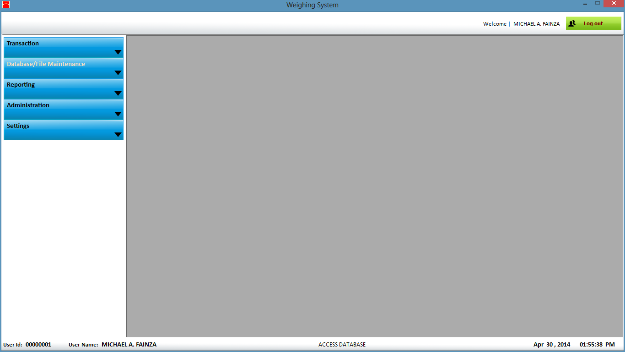
MAIN MENU
For Successful login and server connection, main module will appear.

Slide 5
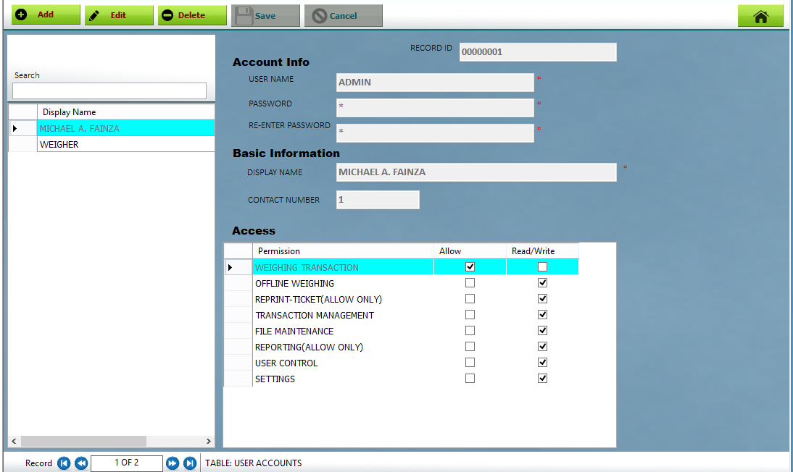
USER CONTROL
MAIN MODULE-> ADMINISTRATION->User Accounts

Slide 6

4.1 CREATING NEW USER
Go to MAIN MODULE-> ADMINISTRATION->User Accounts . Just Click
and enter your display name (Name that you want to appear on your weighing ticket), User name and password for your login account, Check the desired permission to the user then
click .
4.2 MODIFYING USER
To modify user, click and set your desired info and features then click . System will prompt you to logout the system to refresh changes made to your account
4.3 REMOVING USER
To remove or delete user, highlight the row/s or user that you want to delete then click and click yes for confirmation. Note: You cannot delete user that is currently logged-in

Slide 7
USER CONTROL
MAIN MODULE-> ADMINISTRATION->User Accounts

Slide 8
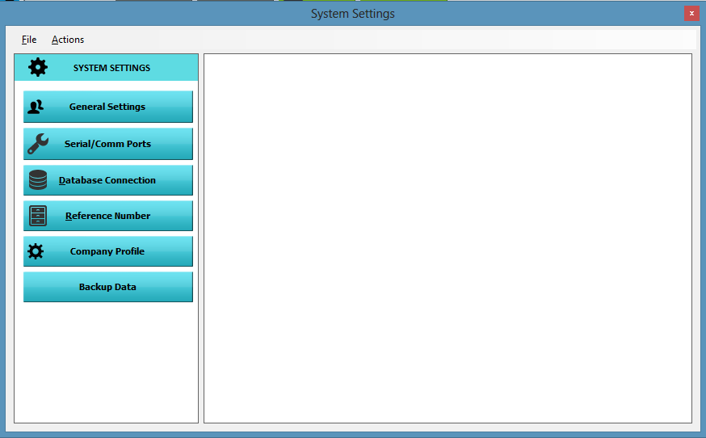
USER CONTROL
MAIN MODULE-> Settings> System Settings

Slide 9
GENERAL SETTINGS
TRANSACTION TYPE -
Single Weighing - Enable this option if you want to use the software as a Single Weigh transaction.
In/Out Weighing – Enable this option if you want to use the software as a standard weigh-in and out transaction.
SYSTEM UNIT WEIGHT
Kg - Converts Weight Device Signal to Kilogram
Tons - Converts Weight Device Signal to Tons
ENABLE PRICING To Enable Pricing, Just click Edit Button and check
then click Save. - Unit Per Price Per Kilogram - Computes Total Amount in Per Price per Kilo. Per Tons - Computes Total Amount in Per Price per Kilo.
ENABLE /DISABLE TICKET PRINTOUT
Enables/Disables Ticket Printout during Transaction.

Slide 10
ENABLE /DISABLE TICKET PRINTOUT -
Enables/Disables Ticket Printout during Transaction.
Print In and Out Seperately
2 printings will occur for every transaction. Inbound details will be printed separately to outbound details.
Print All details at Weigh-Out
Prints all details during Outbound only.
SERIAL/COMM PORTS
DATABASE SETTINGS (See Slide 3)
REFERENCE SETTINGS - Lets you set your desired transaction reference no. To edit reference no. just click edit button, Type the desired reference from the textbox provided and click save.

Slide 11
ENABLE /DISABLE TICKET PRINTOUT -
Enables/Disables Ticket Printout during Transaction.
Print In and Out Seperately
2 printings will occur for every transaction. Inbound details will be printed separately to outbound details.
Print All details at Weigh-Out
Prints all details during Outbound only.
DATABASE SETTINGS (See Slide 3)
REFERENCE SETTINGS - Lets you set your desired transaction reference no. To edit reference no. just click edit button, Type the desired reference from the textbox provided and click save.

Slide 12
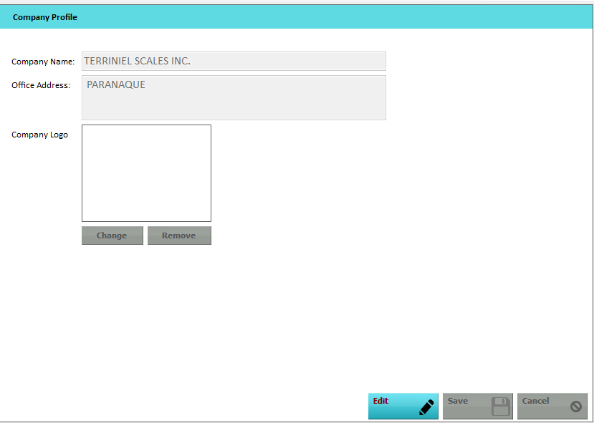
COMPANY PROFILE
Lets you store a brief Information about your company such as Name and address with corresponding Photo.

Slide 13
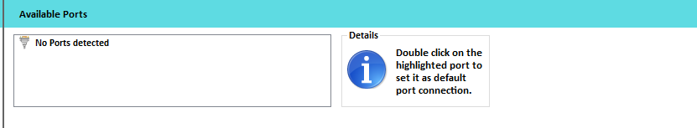
COMPANY PROFILE
Lets you store a brief Information about your company such as Name and address with corresponding Photo.
Connected ports will be detected by the system. Just double click selected port to set it.

Slide 14
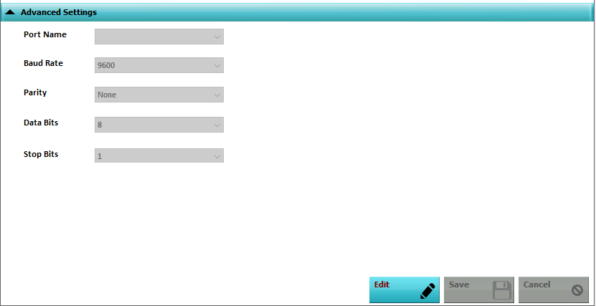
The settings below except for Port name, depends on the configuration of Indicator.

Slide 15
COMPANY PROFILE
Lets you store a brief Information about your company such as Name and address with corresponding Photo.

Slide 16
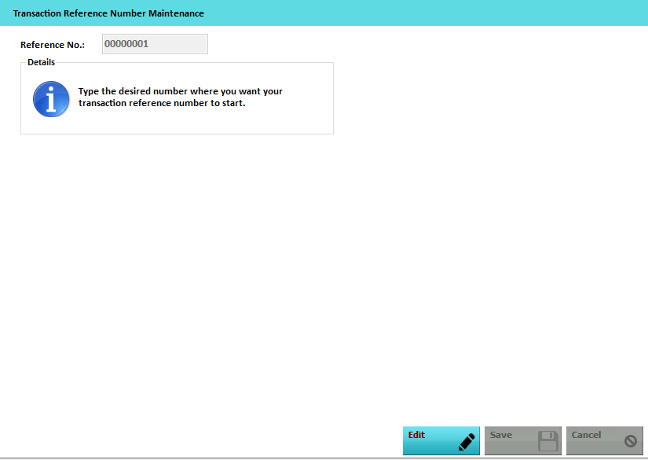
REFERENCE SETTINGS
Lets you set your desired transaction reference no. To edit reference no. just click edit button, Type the desired reference from the textbox provided and click save.

Slide 17
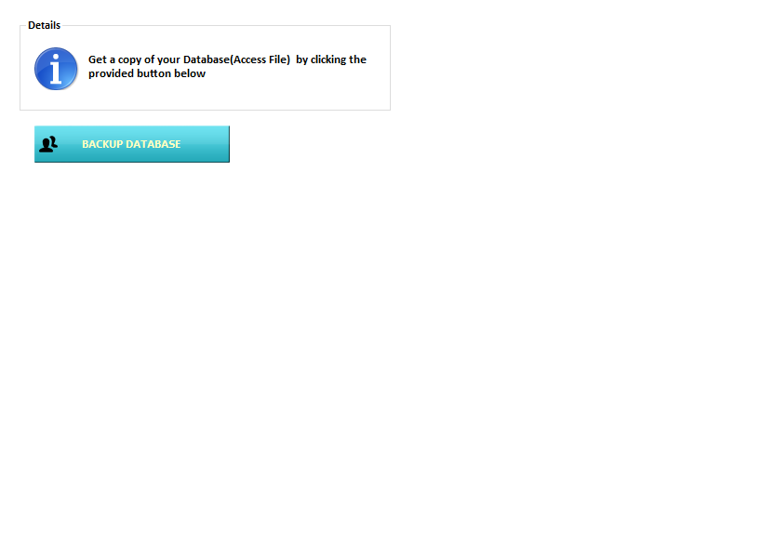
BACKUP DATA
Creates a copy of your database(access file) for backup purposes.
- To create a backup, just click , browse to the location where you want your database to be backup then click save

Slide 18
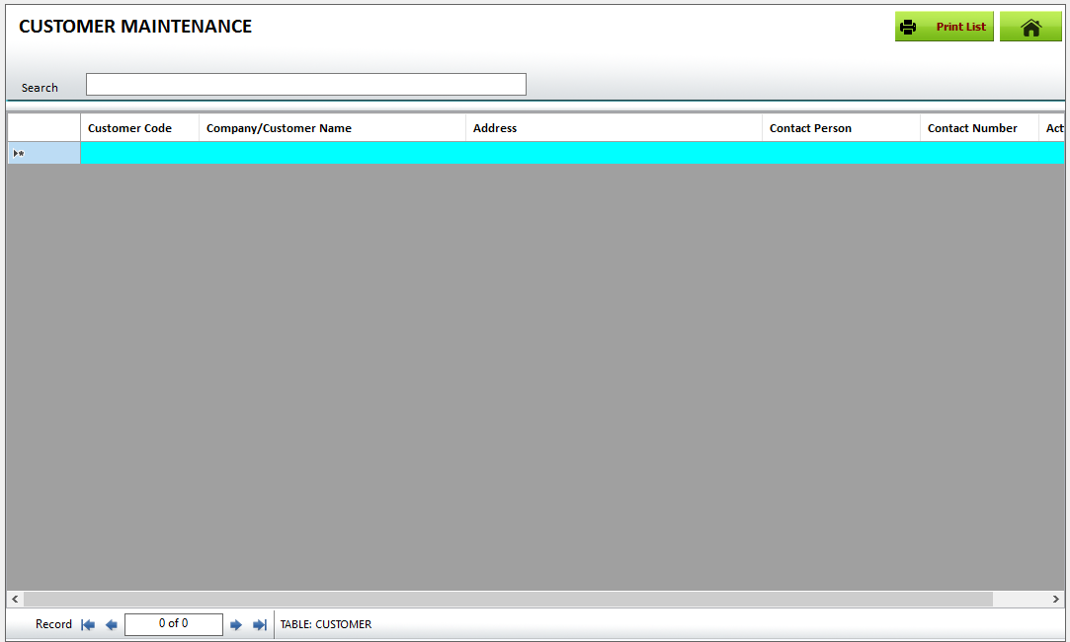
DATABASE/FILE MAINTENANCE
MAIN MENU -> DATA/FILE MAINTENANCE

Slide 19
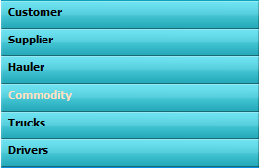
ADDING NEW DATA
STEP 1: Under the Main Menu Window, Click
STEP 2: Click from the button where you want to add/modify/delete data.
STEP 3: Just Scroll down to the empty row and type in the data that you want to add then press enter.
MODIFYING/EDITING DATA REPEAT STEP 1 & 2 STEP 3: Just Scroll to the row of the data that you want to modify, just type in the changes then press enter.
DELETING/REMOVING DATA REPEAT STEP 1 & 2 STEP 3: Just Scroll to the row of the data that you want to delete then press Delete button on your keyboard then press yes for message box confirmation that appeared.

Slide 20
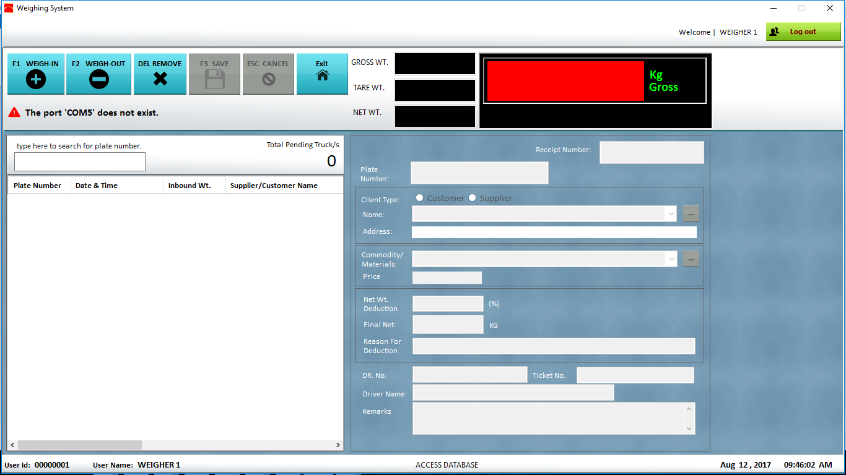
TRANSACTION WINDOW
MAIN MENU -> TRANSACTION->TRANSACTION
.

Slide 21

WEIGH-IN PROCEDURE
STEP 1: By opening the transaction window, click or press F1 in your keyboard to proceed to Weigh-in.
STEP 2: Enter the desired details such PLATE NUMBER, CLIENTS, COMMODITY, DRIVER NAME etc.

Slide 22

RECEIPT NUMBER
Receipt number is auto generated by the system.
(You can edit receipt under settings->Reference number)
PLATE NUMBER
(NOTE: It is strongly suggested to set a uniform format for entering plate number to avoid duplication of entry.)
You cannot enter plate number that is already in the pending list.

Slide 23

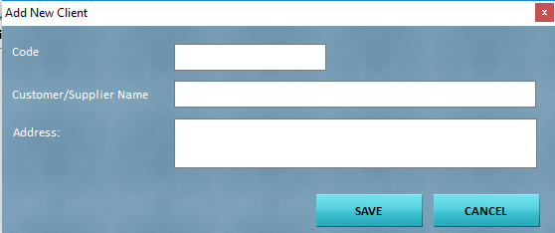
CLIENT
the needed value was not found in the drop down box, click beside the commodity box and this window below will appear.
Enter the needed fields and click SAVE.
You can see now the new value that you have added.

Slide 24

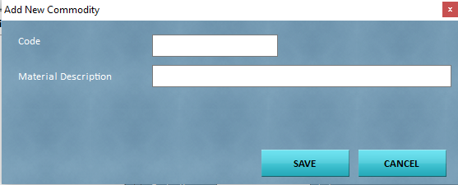
COMMODITY
select first if it is customer or supplier. If the needed value was not found, click and this window below will appear.
Enter the needed fields and click SAVE. You can see
now the new value that you have added.
(Note: Price can only be encoded in the Database/File maintenance window)

Slide 25
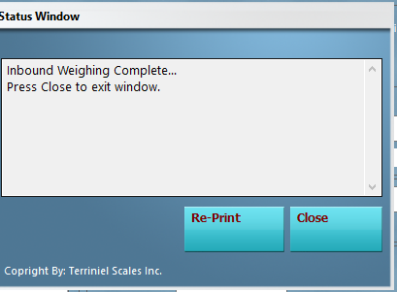
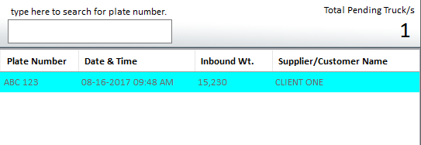
STEP 3: If all the fields are encoded, you can now let the vehicle sit on the truckscale , wait for its stable weight state and click SAVE and YES for confirmation. A status window will appear after the confirmation.
You will notice that a new row is added to the pending list.

Slide 26
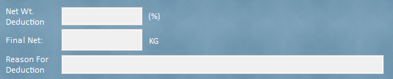
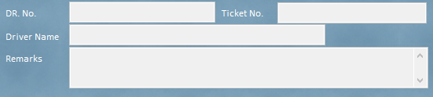
NET WEIGHT DEDUCTION
Net weight deduction should be entered upon weigh-out.
OTHER DETAILS
These fields are not required.

Slide 27

WEIGH-OUT PROCEDURE
STEP 1: If a truck is now ready for weigh-out, select the record in
the pending list and click or press F2 on your keyboard.
(Note: You can re-edit the fields during weigh-out)
STEP 2: Let the vehicle sit on the truck scale , wait for its stable weight state and click SAVE and YES for confirmation. A Receipt ticket will automatically print and status window will appear after the confirmation. The selected record will disappear in the list.
You can re-print the ticket by pressing RE-PRINT button in the status window.

Slide 28
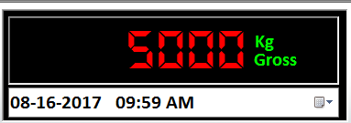
MANUAL WEIGHING
This feature is limited to standard user. You can activate manual weighing by going to Transaction window and press
CTRL+SHIFT+F2. You will notice that the weight pane will turn red and a date time box will appear. Now you can manually set the weight that you want.

Slide 29

DELETING PENDING TRANSACTION
There are two ways to delete pending transaction
Under transaction window select the desired record from the pending the list then click . Press Yes and the record will be permanently deleted.
Under Management Window, Click
change the date
range where the transaction was dated and click generate.
Select the record on the
list and click then yes for confirmation.

Slide 30
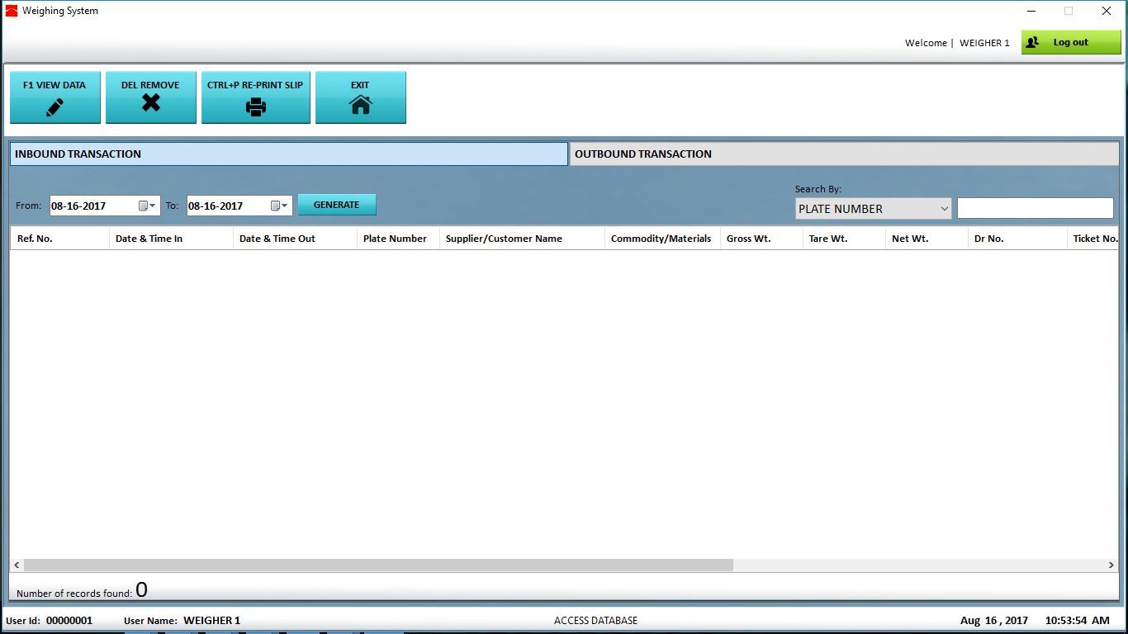
MANAGEMENT WINDOW
MAIN MENU -> TRANSACTION-> MANAGEMENT
Gives you access to view, edit, delete or re-print pending or completed transactions.
.

Slide 31
LISTING TRANSACTION
STEP 1: To see a list of inbound (Pending) transactions click
and
for outbound (completed transaction).
STEP 2: specify the date in the FROM and TO box then click
Generate.
(Note: The default value of From date and To date is the present
date. )

Slide 32
REMOVING COMPLETED TRANSACTION
STEP 1: To delete a completed transaction, click
STEP 2: Set the from to date where the transaction was dated then click generate.
STEP 4: Select the record on the list and click
STEP 3: Press yes for confirmation.

Slide 33

EDITING/VIEWING PENDING /COMPLETED TRANSACTION
STEP 1: To edit a pending transaction, click INBOUND TRANSACTION and OUTBOUND TRANSACTION for completed transactions
STEP 2: Set the from-to date where the transaction was dated then click generate.
STEP 3: Select the record on the list and click or press F1 on your keyboard.

Slide 34

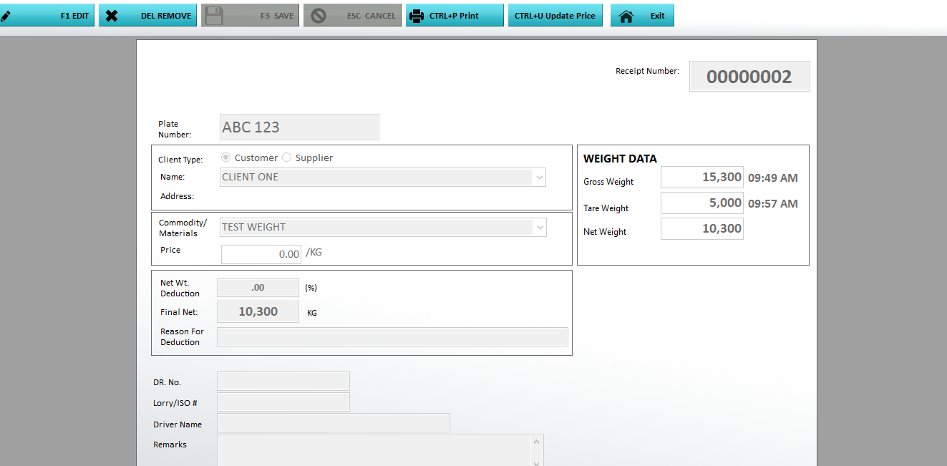
STEP 4: press and the boxes will be available for editing.
STEP 5: Just click SAVE if you are done.
(Note: You can delete or re print transaction under this window)

Slide 35
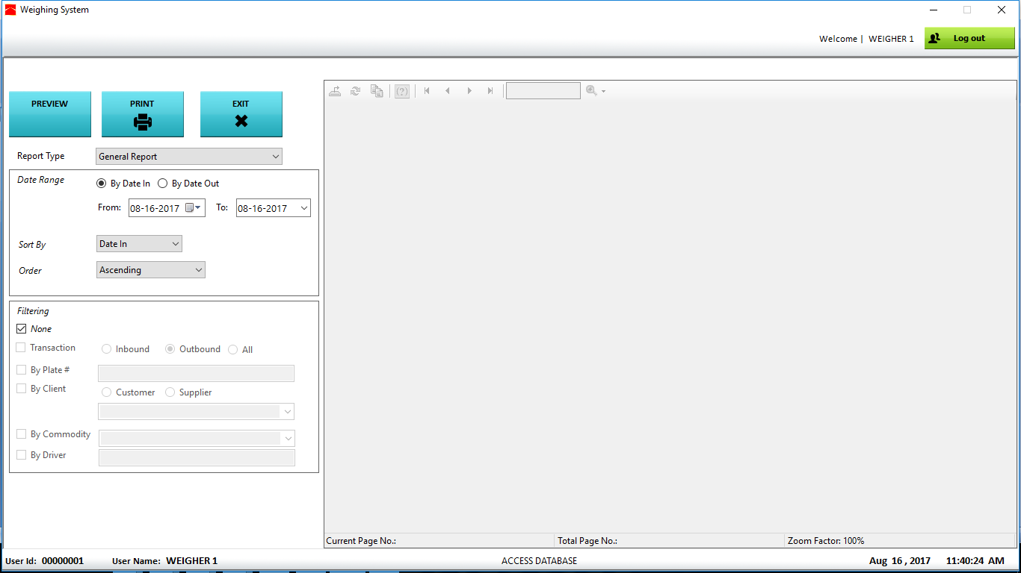
REPORTING WINDOW
MAIN MENU -> REPORTING> TRANSACTION REPORTS
.

Slide 36
GENERATING SUMMARY REPORTS
To generate or make a summary reports, go to MAIN MODULE-> REPORTING-> SUMMARY REPORTS.
SETTING THE DATE RANGE
*DATE RANGE - Transaction date can be generated by Date In(Inbound date) or Date Out(outbound date) depending on your needs and can be sorted by the following fields
SORT BY – (Date In, Date Out, Final Net, Reference No.) Lets you select the fields where you want your report to be arranged.
ORDER BY – Report can be ordered in ascending, descending or original position.

Slide 37
FILTER PANEL
To enable filtering of reports, just check and check also the desired filter category.
Transaction Type (Not applicable to Single Weighing Transaction)
INBOUND – selecting this option will generate only pending transaction
OUTBOUND – selecting this option will generate only completed transaction
ALL – all transaction type will be generated.

Slide 38
Plate Number just check and type in the plate number that you want to filter.
Client - to filter client, just check .Selecting the will list the registered customer in the dropdown box
registered customer in the dropdown box below same with selecting
Commodity - to include commodity in the filter, just check
and select the desired commodity name.
Driver - To also filter driver, just check and type in the driver name

Slide 39


PRINTING/VIEWING REPORTS
After settings the date range and the filter, just click to make the report appear or refresh in the preview panel. Just click if you are ready to print your report.

Slide 40
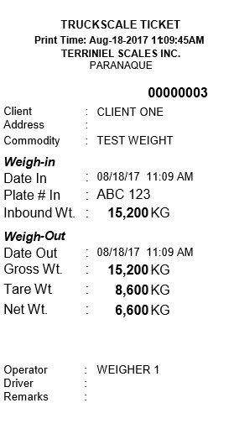
TICKET FORMAT

Slide 41
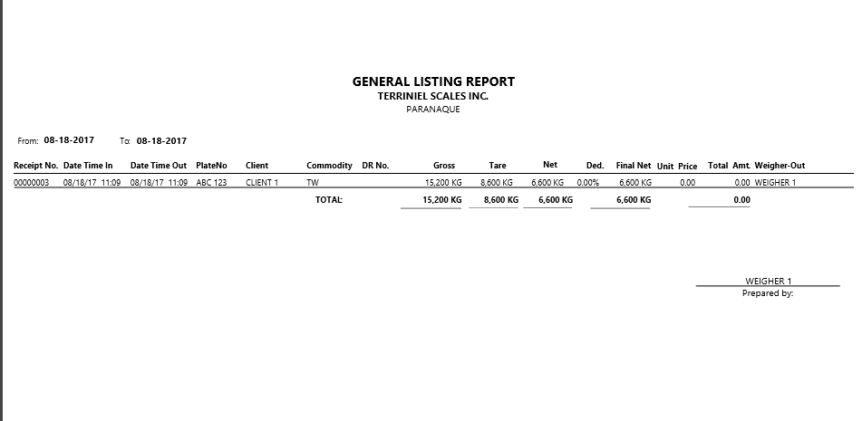
REPORT SUMMARY FORMAT

